Slide 1
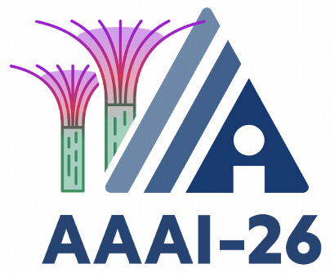


Promptus: Can Prompts Streaming Replace Video Streaming
Jiangkai Wu, Liming Liu, Yunpeng Tan, Junlin Hao, Liang Zhang, Xinggong Zhang
Notes:
Hello everyone. I am Jiangkai.
Today, I present our work: Promptus.
We explore a provocative question: Can Prompts Streaming Replace Video Streaming?
This represents a paradigm shift from transmitting pixels to transmitting semantics.

Slide 2
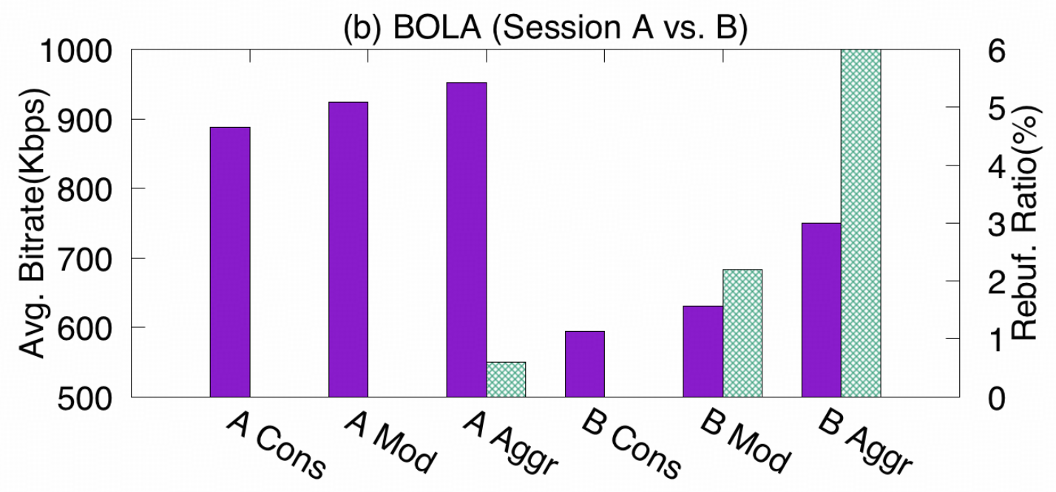

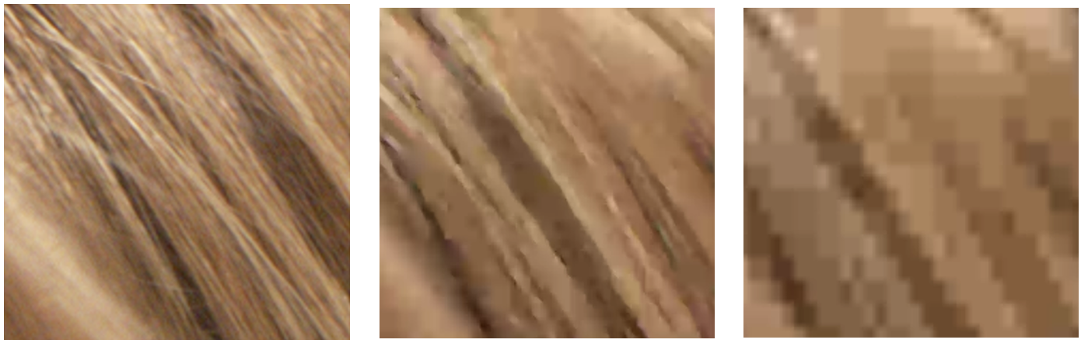
The Video Streaming Dilemma
Video Codecs are approaching their performance envelope.
Trade-off:
  Higher Bitrate -> Stalling Risk
  Lower Bitrate -> Quality degradation
1200 kbps
600 kbps
200kbps
Akhtar, Zahaib, et al. “Oboe: Auto-tuning video ABR algorithms to network conditions.” SIGCOMM 2018.
Notes:
Let's start with the dilemma in current video streaming.
Video codecs are approaching their performance limits, trapping us in a severe trade-off:
Higher bitrates increase the risk of stalling.
Lower bitrates inevitably lead to quality degradation, such as blocking artifacts.
In bandwidth-constrained environments, traditional codecs simply cannot squeeze out more performance.

Slide 3
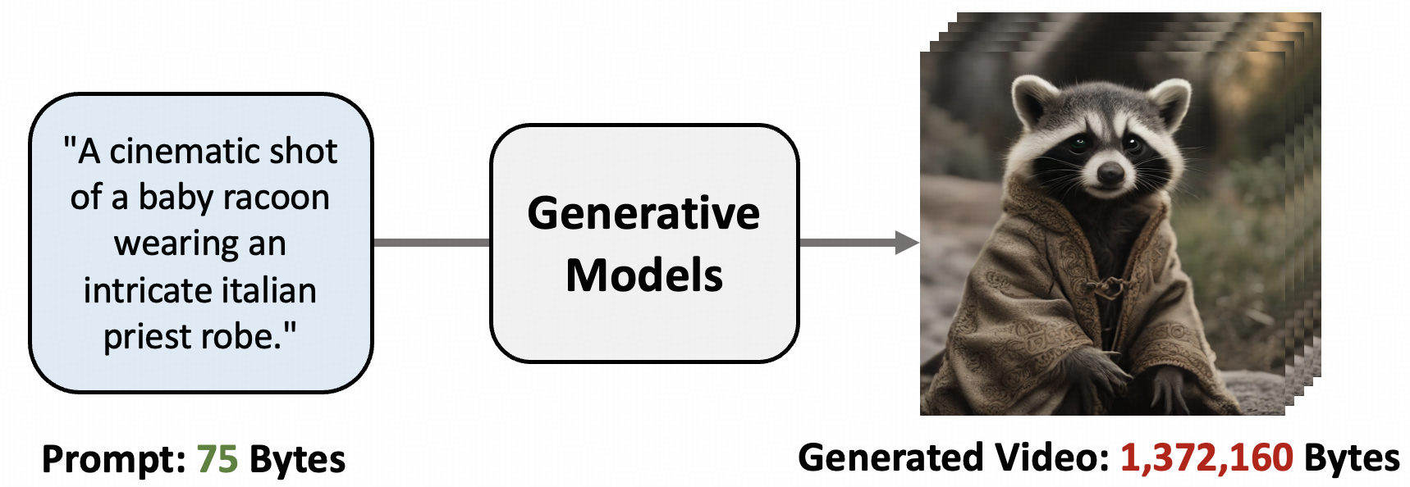
The Generative Opportunity
Information Asymmetry in prompt-to-video generation.
e.g., a 75 bytes prompt generates a 1,372,160 bytes video.
Can we stream Prompts instead of Video, decoupling transmission bitrate from perceptual quality ?
Notes:
However, Generative AI offers a new opportunity.
We observe that Generative AI introduces a massive Information Asymmetry.
Consider this: a tiny prompt of just 75 bytes can trigger a model to generate a video of over 1 Megabyte.
This led us to a bold idea: Can we stream Prompts instead of Video?
We send the “prompt seed", and the receiver "grows" the high-fidelity content.
If we can do this, we can decouple transmission bitrate from perceptual quality.

Slide 4
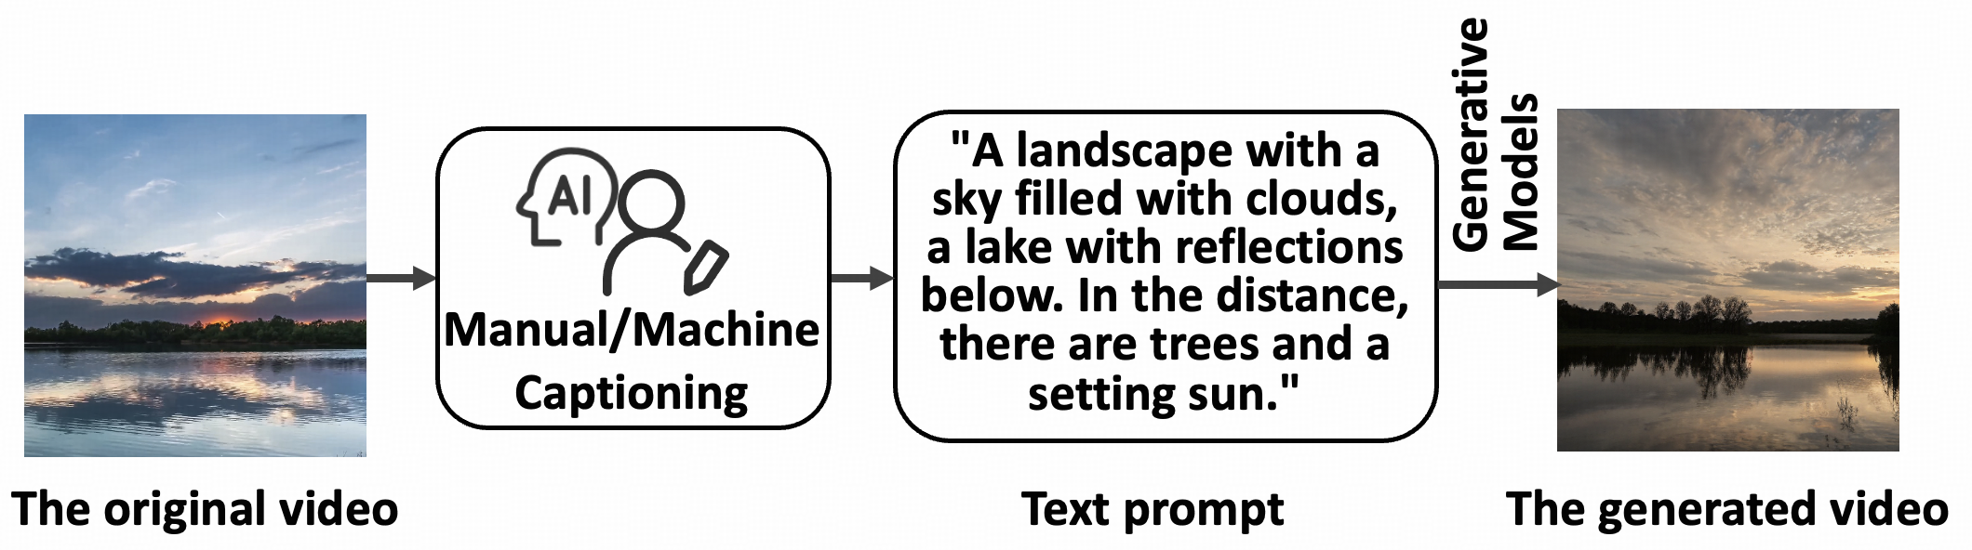
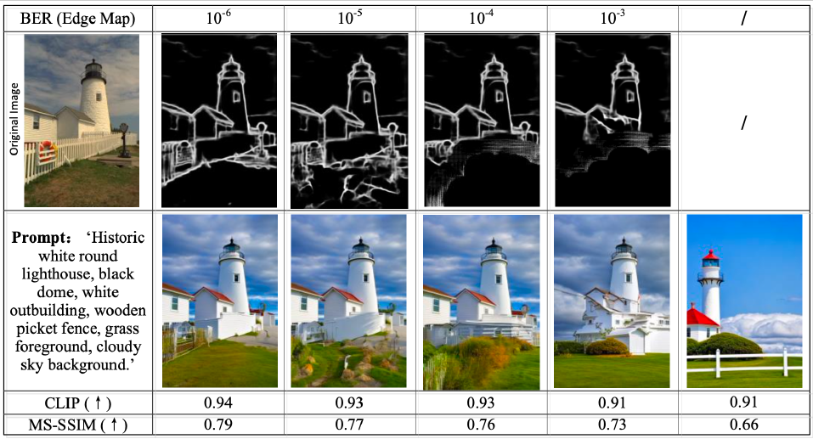
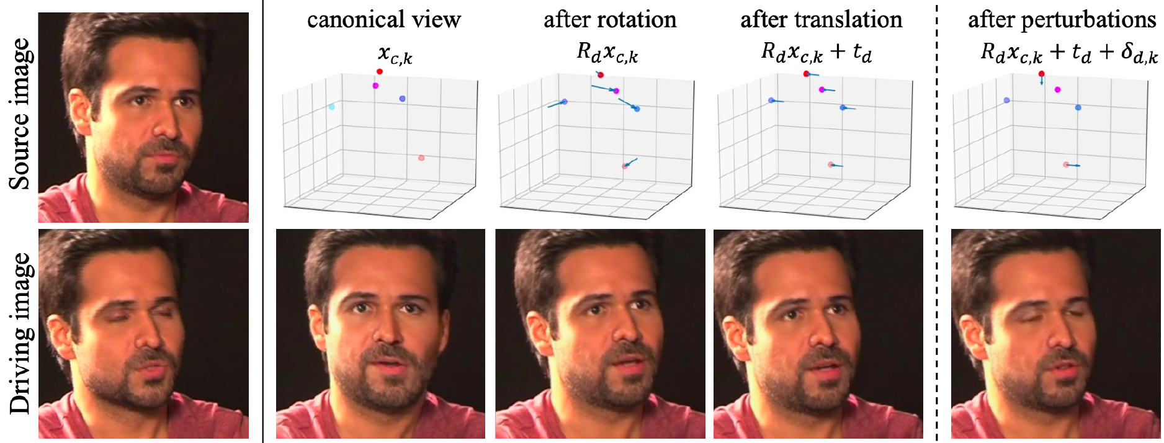
Limitations of Existing Methods
Text Prompt
  e.g., Captioning
  No Pixel Alignment
Structural Guidance
  e.g., ControlNet
  Texture & Color Misalignment
Task-Specific Models
  e.g., Facial Animation
  Limited Domain
Qiao, Li, et al. "Latency-aware generative semantic communications with pre-trained diffusion models." IEEE wireless communications letters 2024.
Wang, Ting-Chun, Arun Mallya, and Ming-Yu Liu. "One-shot free-view neural talking-head synthesis for video conferencing." CVPR 2021.
Notes:
This sounds promising, but existing methods fail to replace video streaming due to critical limitations.
First, Text Prompts: The most direct approach is Video Captioning. You generate a description and send it. But text is too abstract. It only guarantees semantic consistency, not pixel alignment. The generated video might look "correct" conceptually, but it won't be the same video.
Second, Structural Guidance: Tools like ControlNet can align edges, but often fail with texture and color.
Third, Task-Specific Models: Methods like keypoint-driven facial animation work well, but they are limited to specific scenarios like video conferencing.
We need a solution that is both Pixel-Aligned and General for any video content.

Slide 5
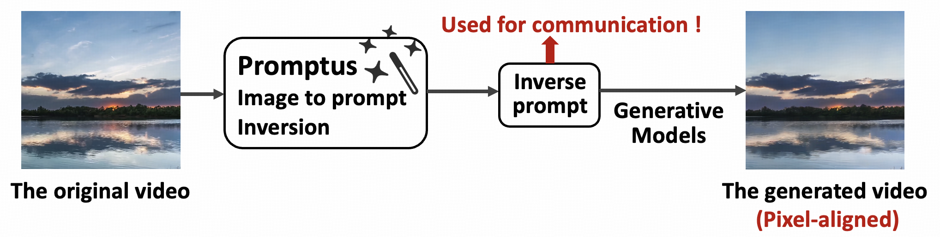




Promptus: Pixel-aligned Inversion for General Video
Pixel-alignment
Human face
Landscape
Animation
Generality
original
generated
original
generated
original
generated
Notes:
This is why we propose Promptus.
It is the first system to achieve Pixel-aligned Inversion for general video streaming.
As you can see in the examples below—whether it's a human face, a landscape, or animation—the generated frames are visually indistinguishable from the originals.
So, how do we achieve this? I will break down our methodology into three key challenges.

Slide 6
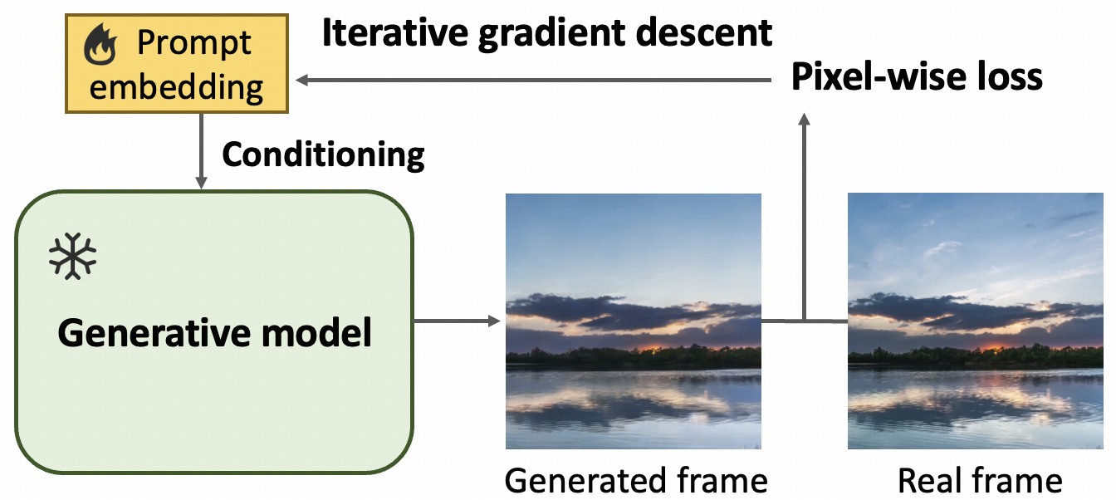
Methodology #1: How to achieve pixel-alignment?
Gradient Descent Based Prompt Fitting
Embedding as Prompt
Directly optimize continuous embeddings instead of discrete text to ensure differentiability.
Gradient Descent Fitting
Iteratively optimize the prompt to minimize the pixel-wise difference between the generated frame and the target frame.
Notes:
Challenge #1: How do we invert a video frame back into a prompt with pixel alignment?
We propose a Gradient Descent Based Prompt Fitting framework.
Crucially, to avoid the non-differentiability of discrete text—which blocks gradient backpropagation—we optimize continuous embeddings instead.
By iteratively updating the embeddings via gradient descent, we minimize the pixel-wise difference between the generated frame and the target frame.
This turns "finding a prompt" into a mathematical optimization problem, guaranteeing pixel-level alignment.

Slide 7
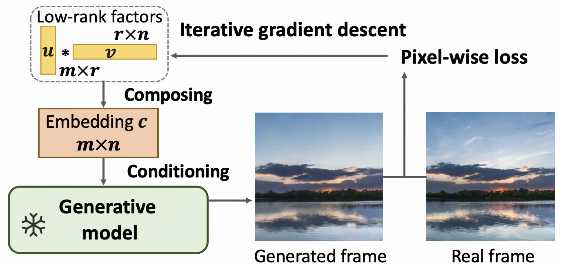



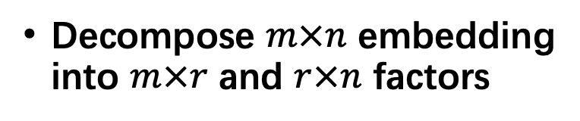
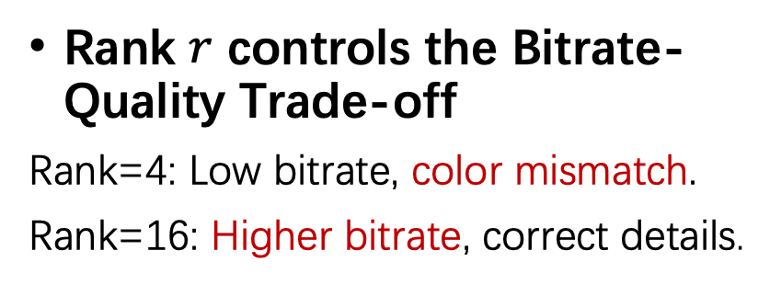
Methodology #2: How to control bitrate?
Low-Rank Decomposition
Decompose $m×n$ embedding into $m×r$ and $r×n$ factors
Rank $r$ controls the Bitrate-Quality Trade-off
Rank=4: Low bitrate, color mismatch.
Rank=16: Higher bitrate, correct details.
Rank=4
Rank=16
Ground Truth
(c)
(a)
(b)
(c)
Notes:
Challenge #2: How do we control the bitrate?
A full embedding matrix is actually large.
To solve this, we introduce Low-Rank Decomposition.
We decompose the embedding matrix into smaller factors.
The Rank becomes our "tuning knob" for the Bitrate-Quality Trade-off.
As shown on the right: at Rank=4, the bitrate is ultra-low, but we lose details like the color of the lamp.
At Rank=16, the bitrate increases, but the details are perfectly restored.
This allows Promptus to adaptively adjust to network conditions, just like a traditional codec.

Slide 8
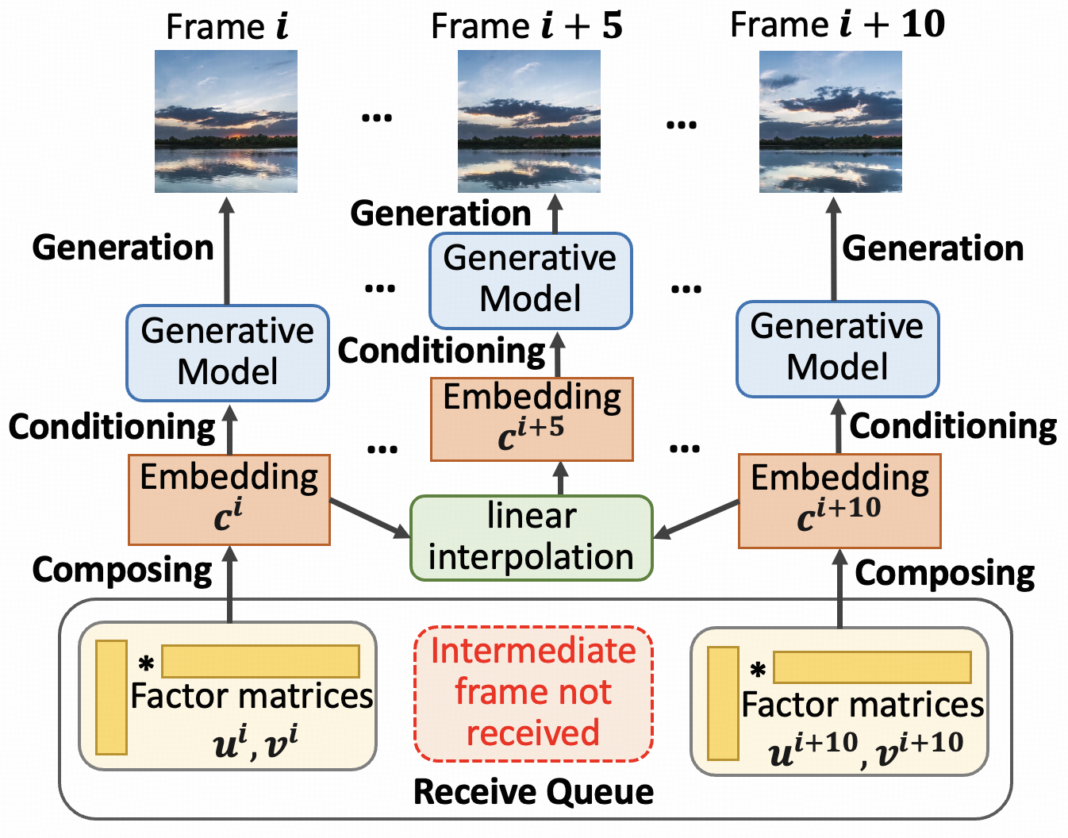
Methodology #3: How to reduce temporal redundancy? Interpolation-aware Compression
Prompts exhibit strong continuity, allowing sparse transmission.
Approximate intermediate frames via prompt interpolation.
Prompt
Interpolation
e.g., interpolating at 10-frame intervals.
Notes:
Challenge #3: How do we handle temporal redundancy?
Inverting every single frame is inefficient because adjacent frames share much of the same content.
We discovered that in the prompt space, adjacent frames exhibit strong continuity.
Therefore, we propose Interpolation-aware Compression.
We only sparsely transmit prompts for keyframes.
The intermediate prompts are approximated via Prompt Interpolation.
These interpolated prompts can generate continuous, smooth frames.
This significantly reduces bandwidth usage.

Slide 9
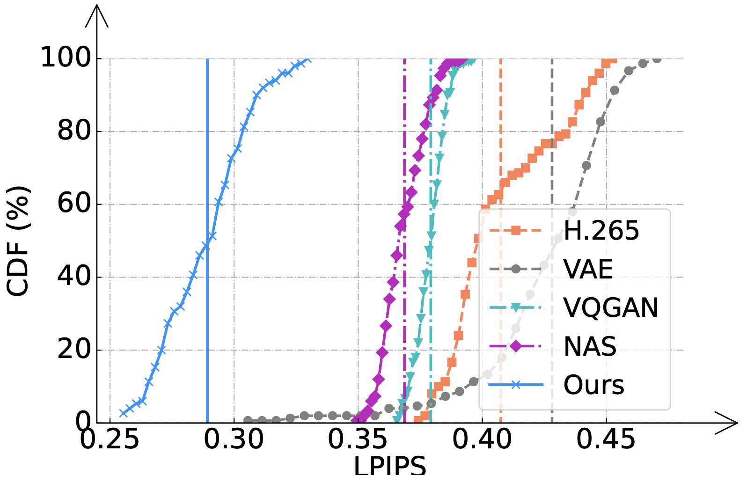
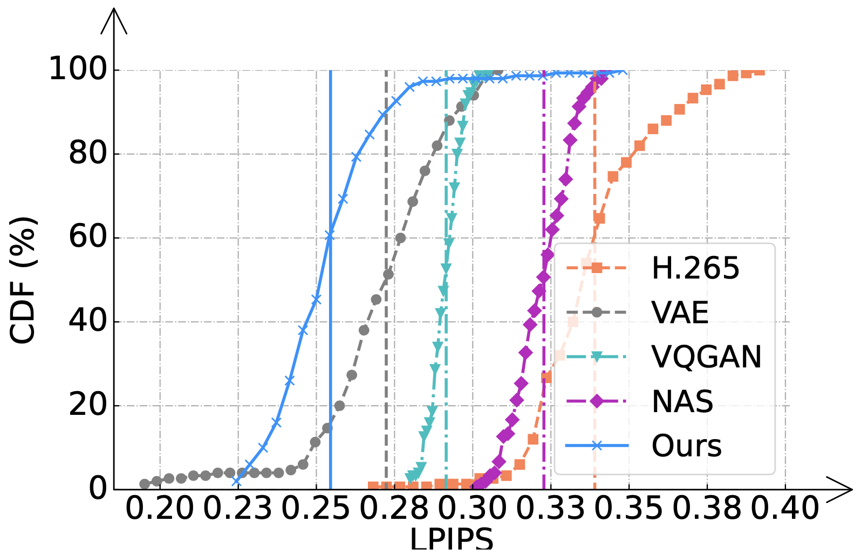
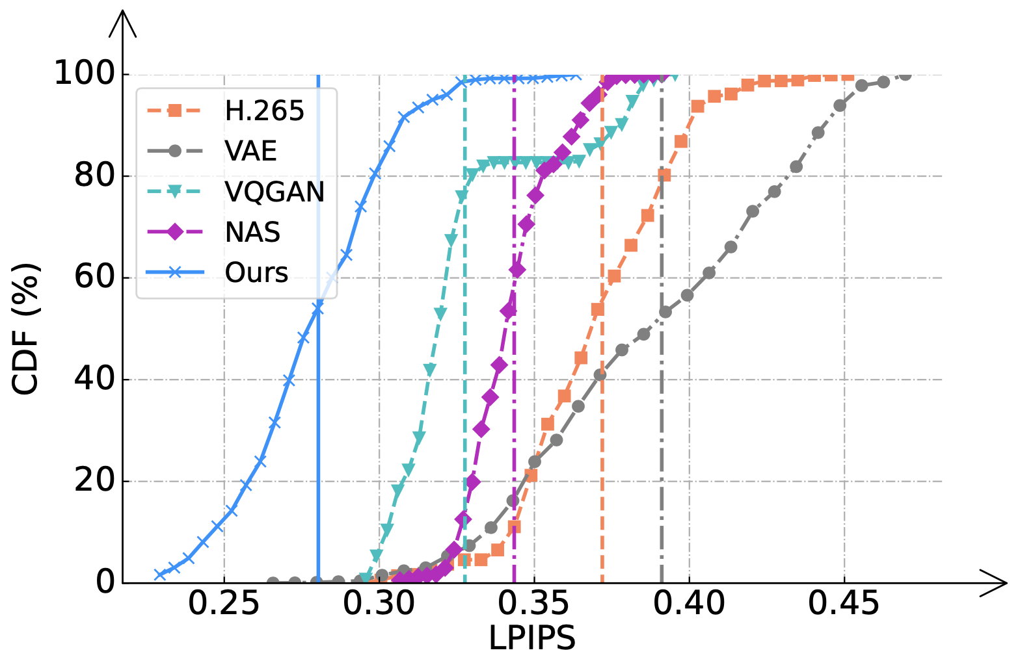
Evaluation#1: Transmission efficiency
4x Bandwidth Saving
  Promptus at 140 kbps achieves better quality than H.265 at 540 kbps.
90% Distortion Reduction
  Fewer severely distorted frames (LPIPS > 0.32) under weak networks.
140 kbps
540 kbps
Real-world traces
Notes:
Now, let's look at the performance.
Promptus achieves a 4x bandwidth saving.
Our result at 140 kbps achieves a perceptual quality comparable to H.265 at 540 kbps.
While H.265 fails completely at 140 kbps, resulting in severe blocking, Promptus maintains high fidelity.
Quantitatively, we reduce the ratio of severely distorted frames by 90%.

Slide 10
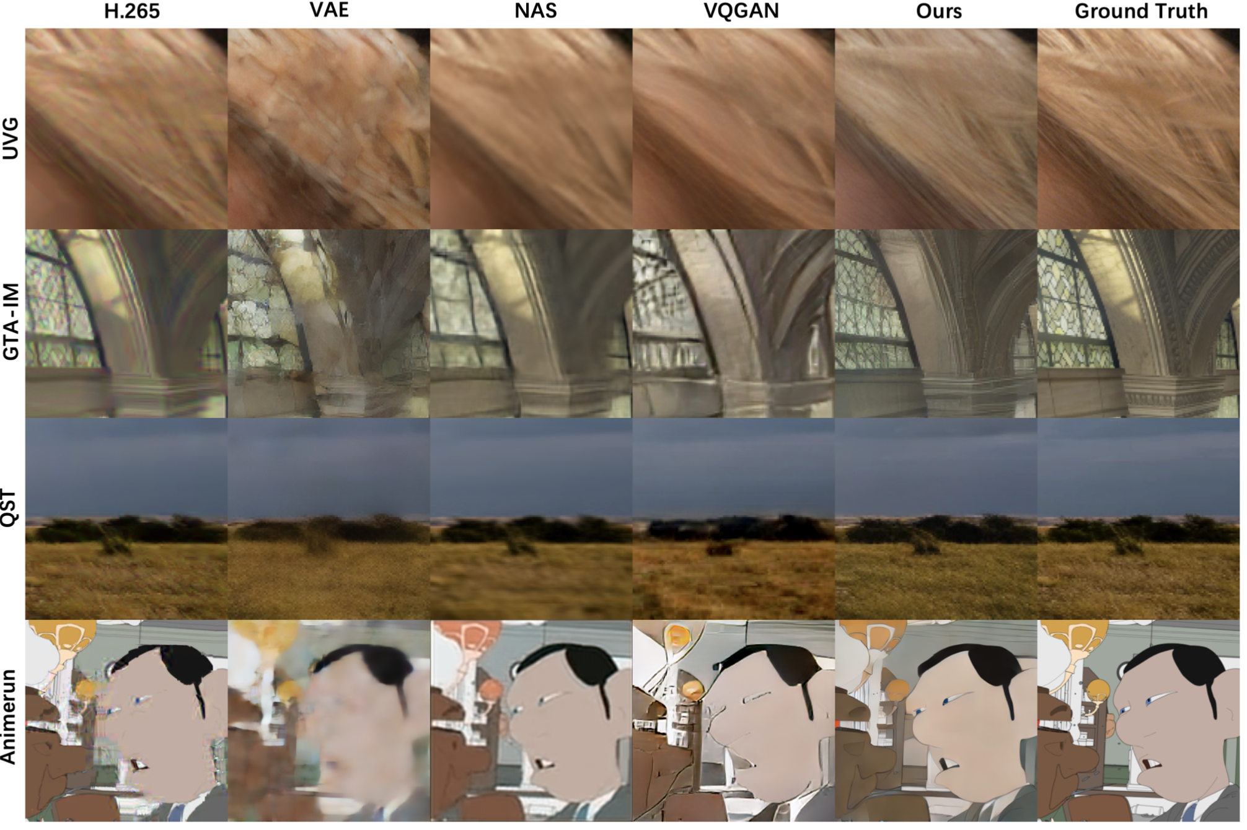
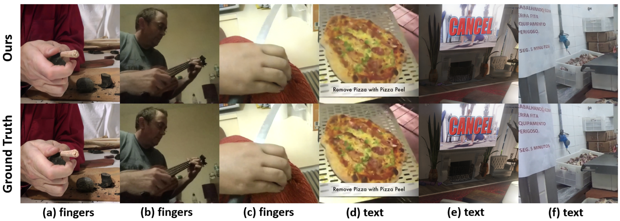
Evaluation#2: Generality
Generality across Domains
Handling Corner Cases
Notes:
Regarding Generality:
We evaluated Promptus across diverse domains: close-up portraits, natural landscapes, 3D games, and 2D animations. It consistently outperforms baselines.
Even for challenging cases involving details that generative models typically struggle with—such as text and fingers—our end-to-end gradient fitting allows us to reconstruct them accurately.

Slide 11
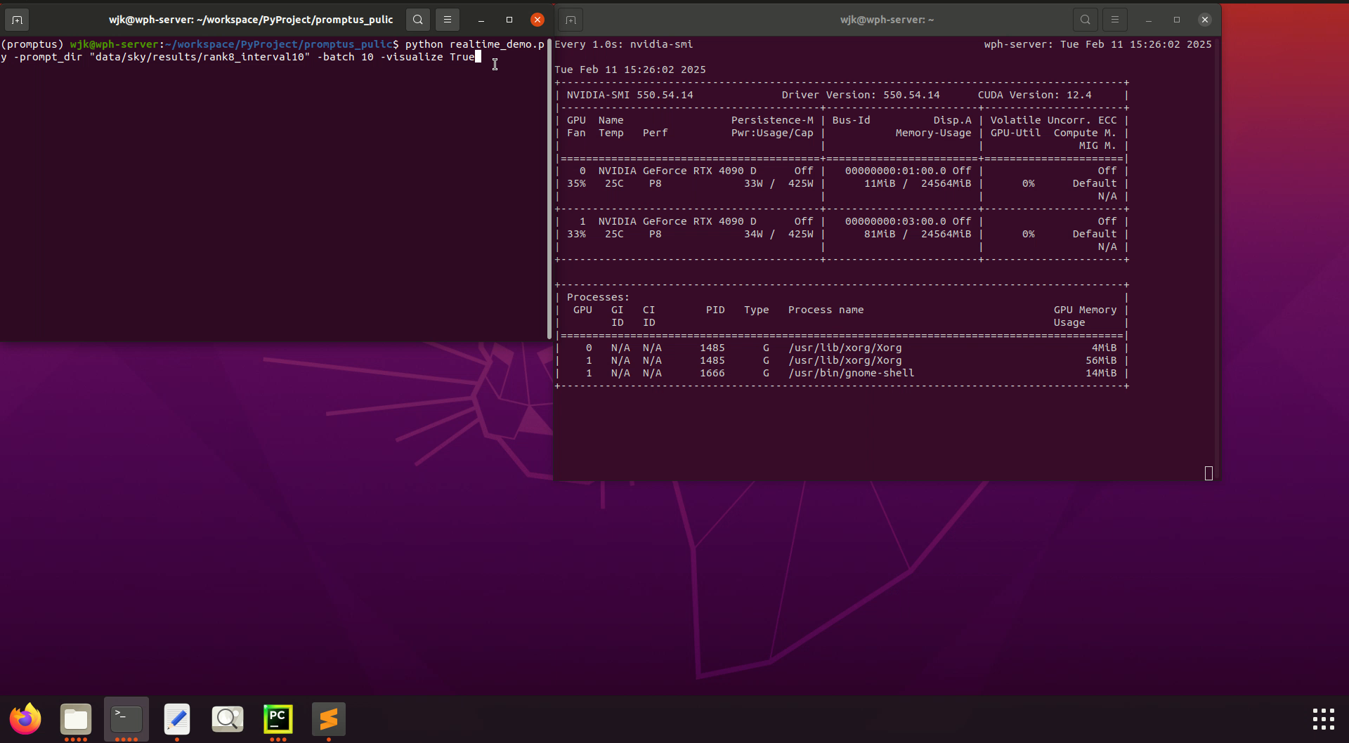
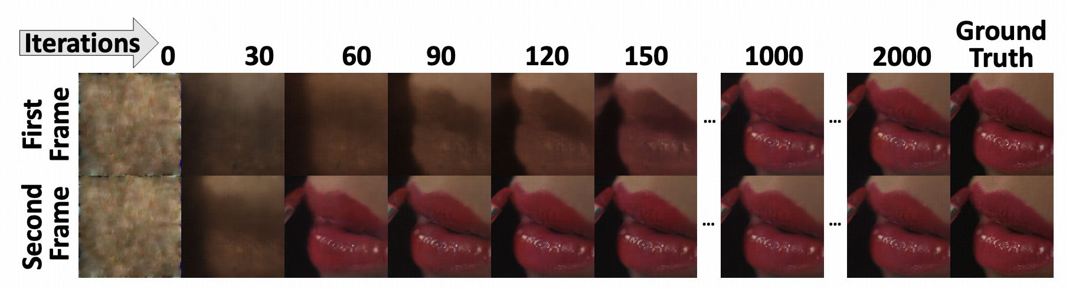
Evaluation#3: Overhead
Sender Side (Inversion)
  First Frame: 2k-10k iterations
  Subsequent Frames: 120-500 iterations
  10 GB Memory
Receiver Side (generation)
  170+ FPS on RTX 4090D
  7846 MB Memory
Notes:
Let's look at the system Overhead.
On the Receiver Side: It is fast. We achieve 170+ FPS on an RTX 4090, fully supporting real-time playback.
On the Sender Side: This is the current bottleneck. The inversion process requires iterations, causing high latency. This makes Promptus currently more suitable for Video-on-Demand.

Slide 12

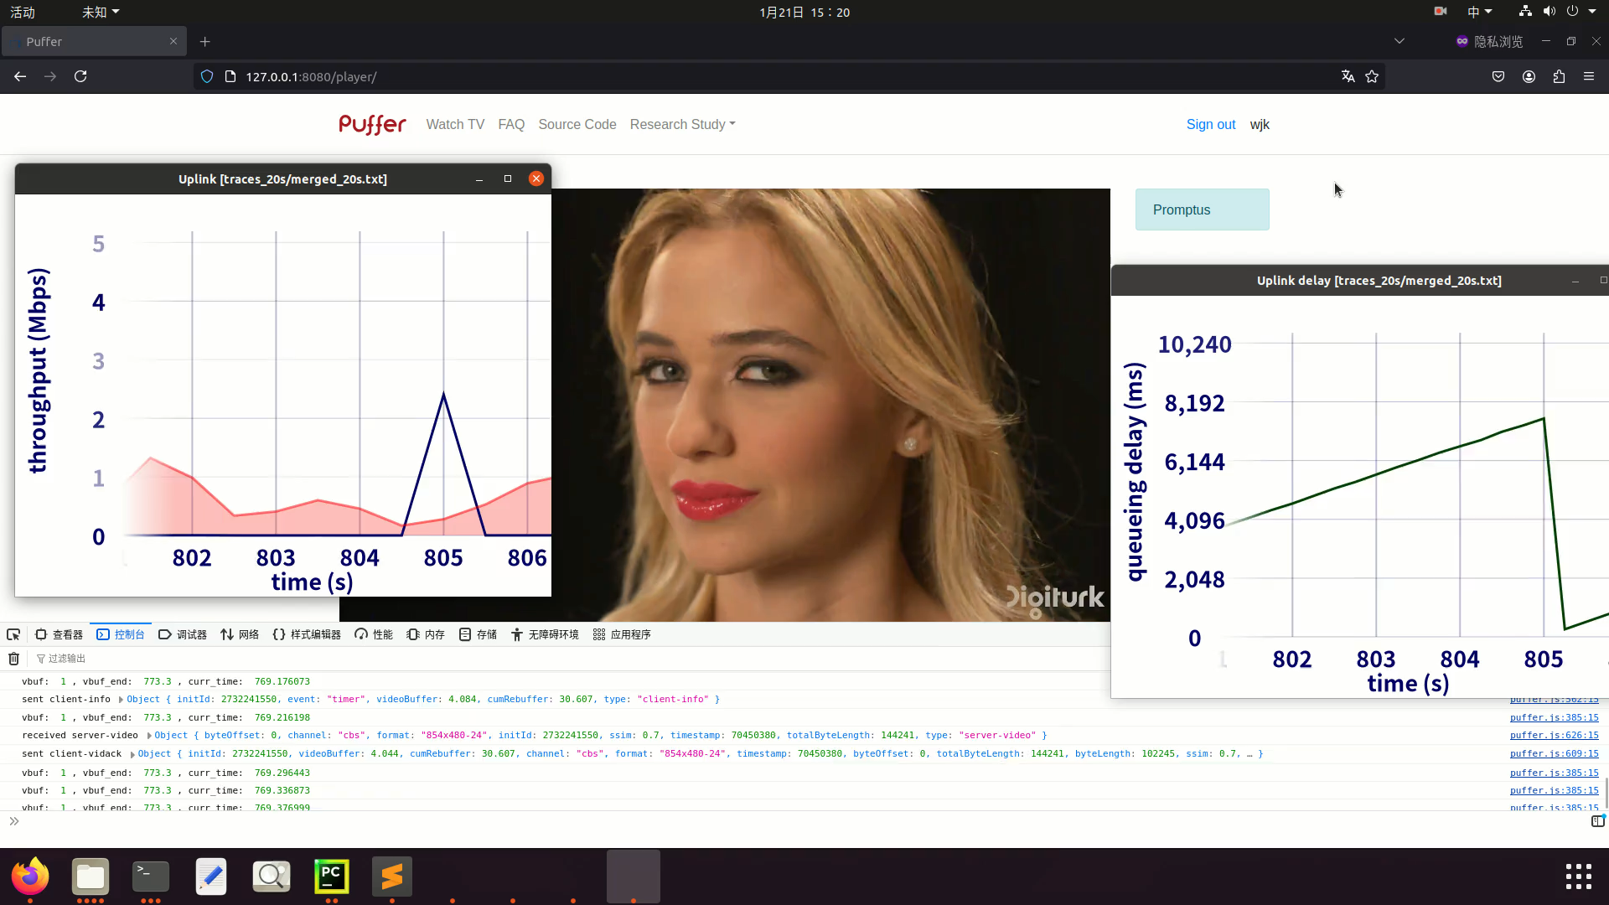

Prototype & Open source
Integration with the streaming platform Puffer
  featuring a custom-built media server, prompt channel, and web player.
Open sourced: https://github.com/JiangkaiWu/Promptus
  Github
  Prototype
Notes:
To prove the feasibility, we built a full Prototype.
We integrated Promptus into the video streaming platform Puffer, featuring a custom media server and web player.
To facilitate future research, our code is open-sourced on GitHub. We invite you to try it out.

Slide 13
Conclusion, Limitation & Takeaway
Paradigm Shift
  Promptus is the first system to replace video streaming with prompt streaming, achieving pixel-alignment.
Limitation
  The high latency of inversion renders Promptus unsuitable for real-time video communication.
We don't need to send the world. We just need to send the Key (Prompt) to unlock the world that's already in the model.
Notes:
To conclude: Promptus represents a Paradigm Shift.
It is the first system to replace video streaming with prompt streaming while ensuring pixel alignment.
While sender-side latency remains a challenge for future work, the potential is clear.
Here is the key takeaway: "We don't need to send the world. We just need to send the Key—the Prompt—to unlock the world that is already inside the model."

Slide 14
Thank you for your attention!
For any questions or further discussion,
please contact: jiangkai.wu@stu.pku.edu.cn
Notes:
If you have any detailed questions, please contact via email.
Thank you very much for your attention.

