Slide 1
Chat with AI: The Surprising Turn of Real-time Video Communication from Human to AI
Jiangkai Wu, Zhiyuan Ren, Liming Liu, Xinggong Zhang
Peking University

Slide 2
Background: AI Video Chat
Large Language Model — Text Input
Large Language Model
…
Text Tokens

Slide 3
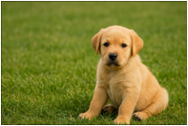
Background: AI Video Chat
Follow-up works (like GPT-4V) add visual input, enabling it to see
Large Language Model
…
Text Tokens
Vision Encoder

Slide 4

Background: AI Video Chat
Subsequent works (e.g., GPT-4o) integrate audio input, so now it can hear.
Multimodal Large Language Model (MLLM)
…
Text Tokens
Vision Encoder
Audio Encoder

Slide 5





Background: AI Video Chat
This makes the interaction between humans and AI more intuitive
— as if chatting face-to-face with a real person
Hi, take a look at this, could you ···
Sure, this looks ··· , so we should ···
Multimodal Large Language Model
…
Text Tokens
Vision Encoder
Audio Encoder
+
Response

Slide 6
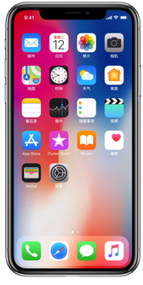

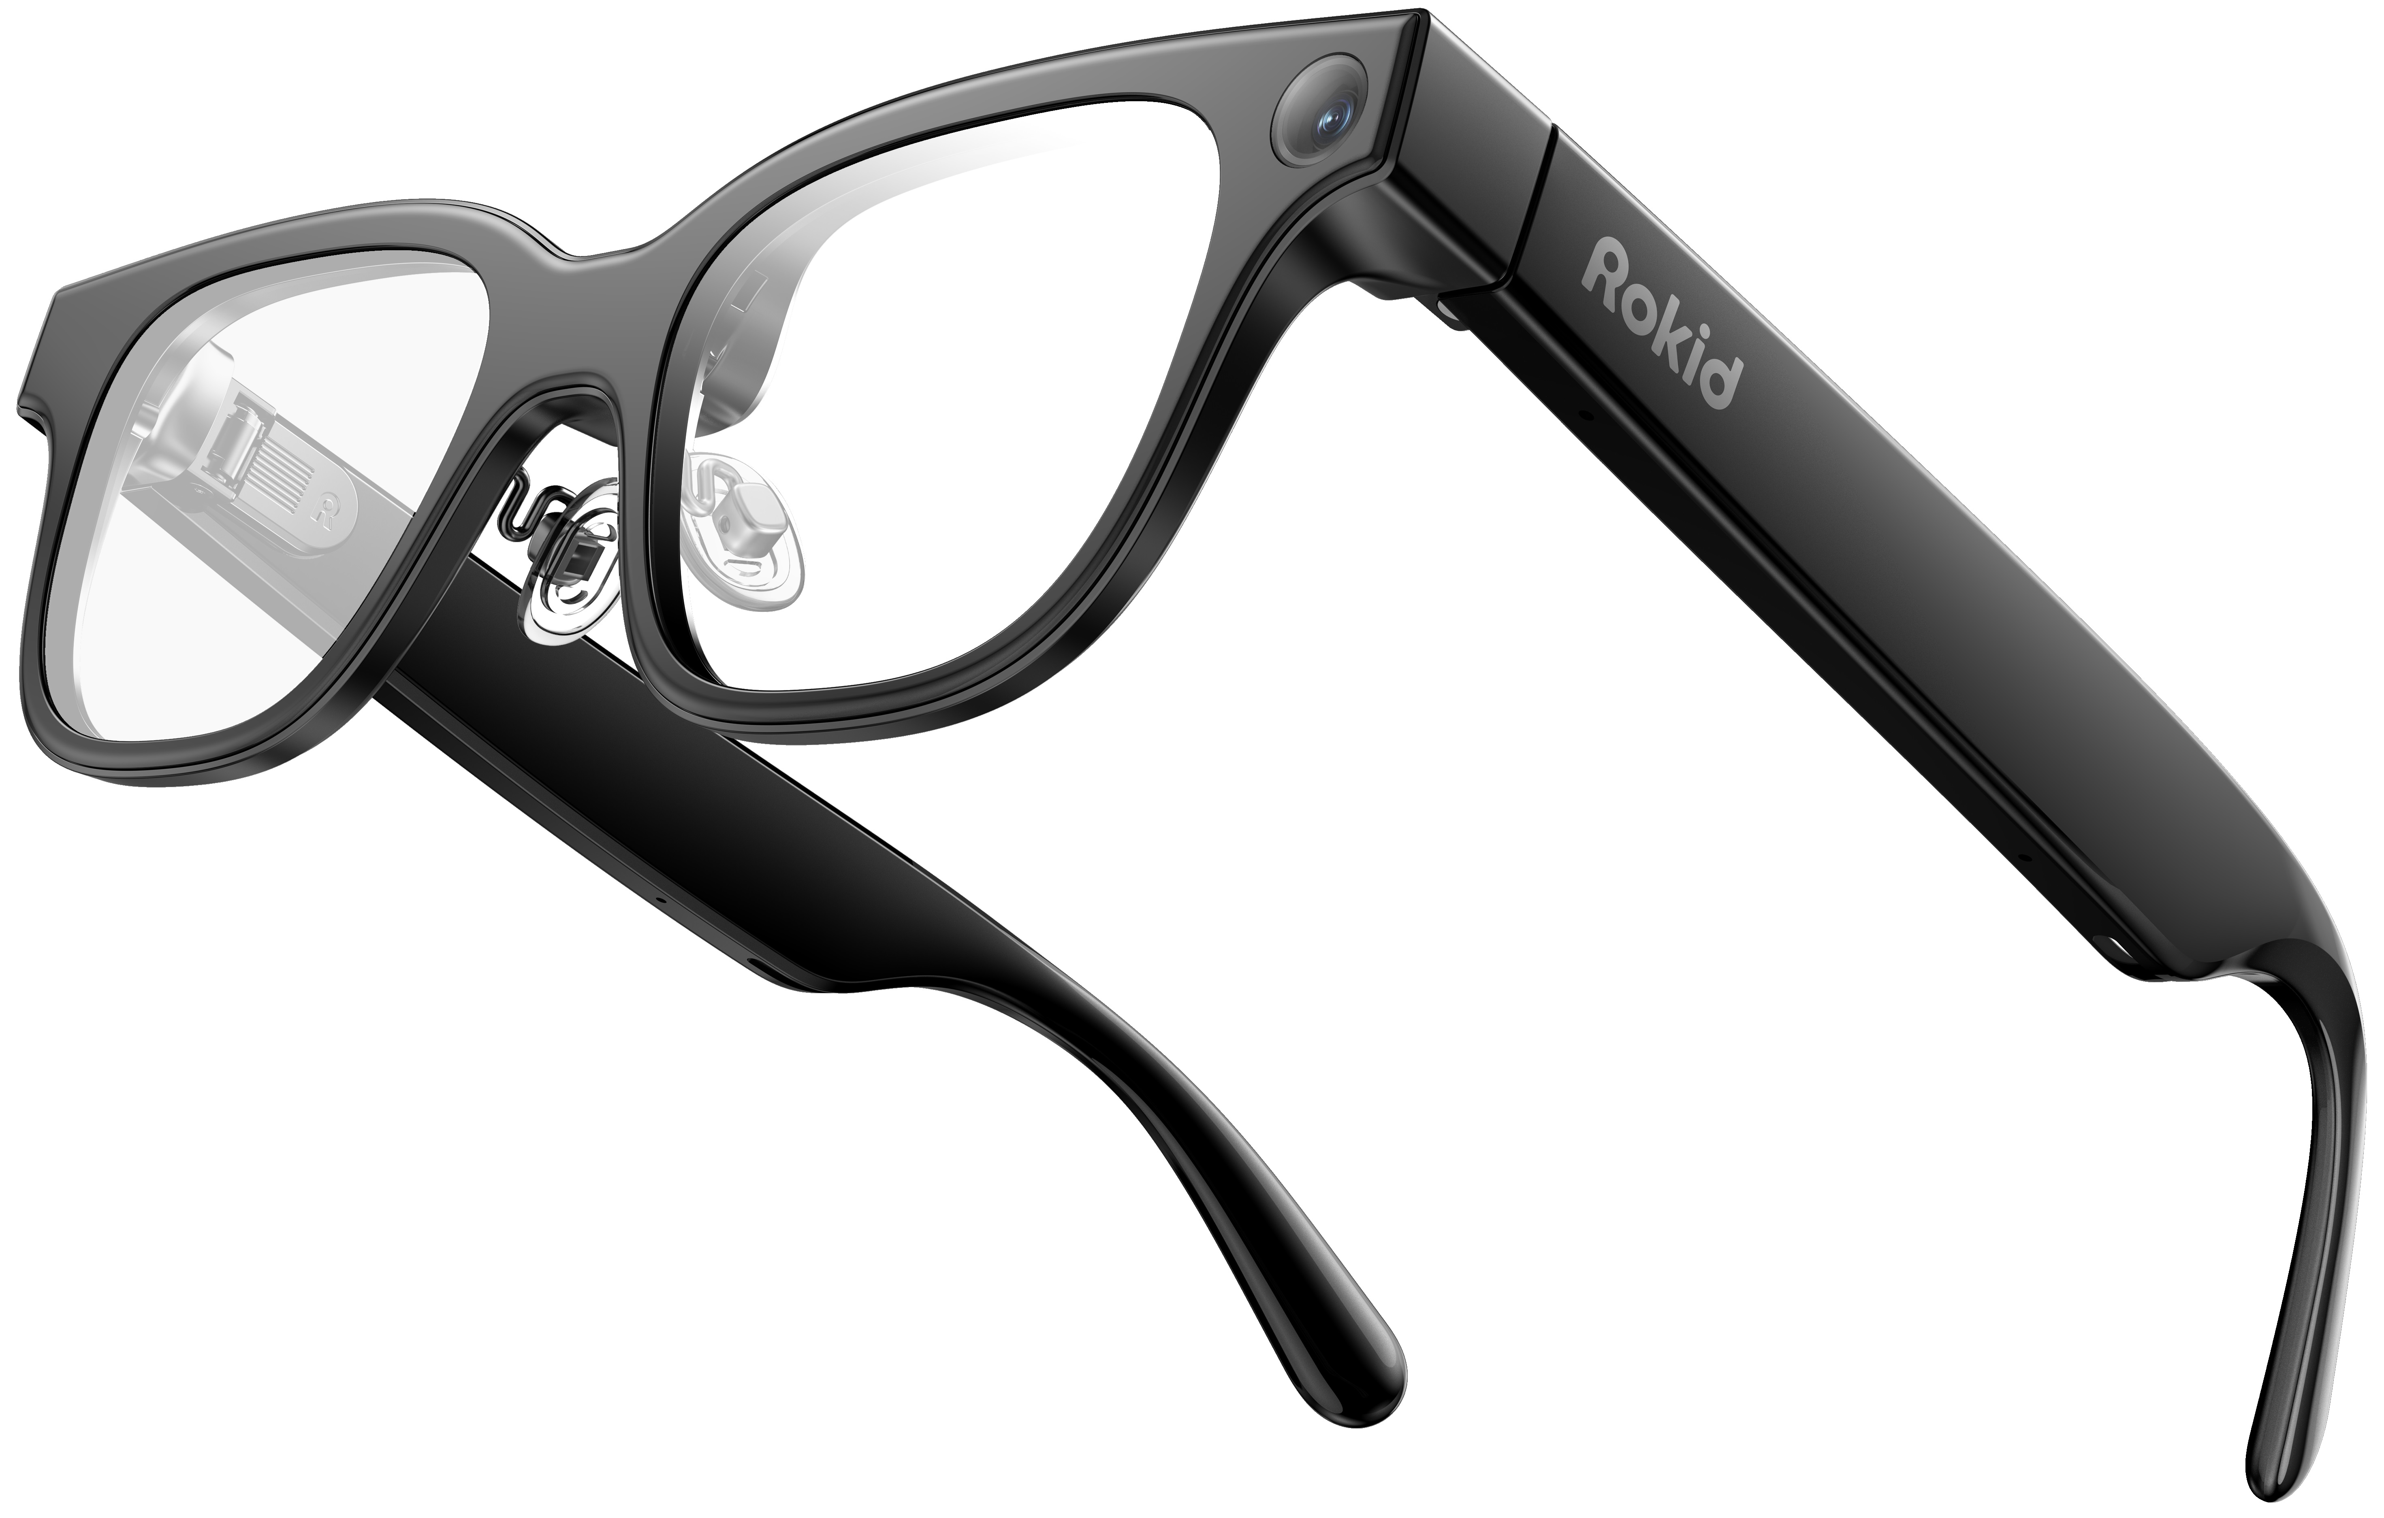
Background: AI Video Chat
Mobile devices cannot meet the computing requirements.
Multimodal Large Language Model
…
Hi, take a look at this, could you ···
Sure, this looks ··· , so we should ···
Text Tokens
Vision Encoder
Audio Encoder
+
Response

Slide 7

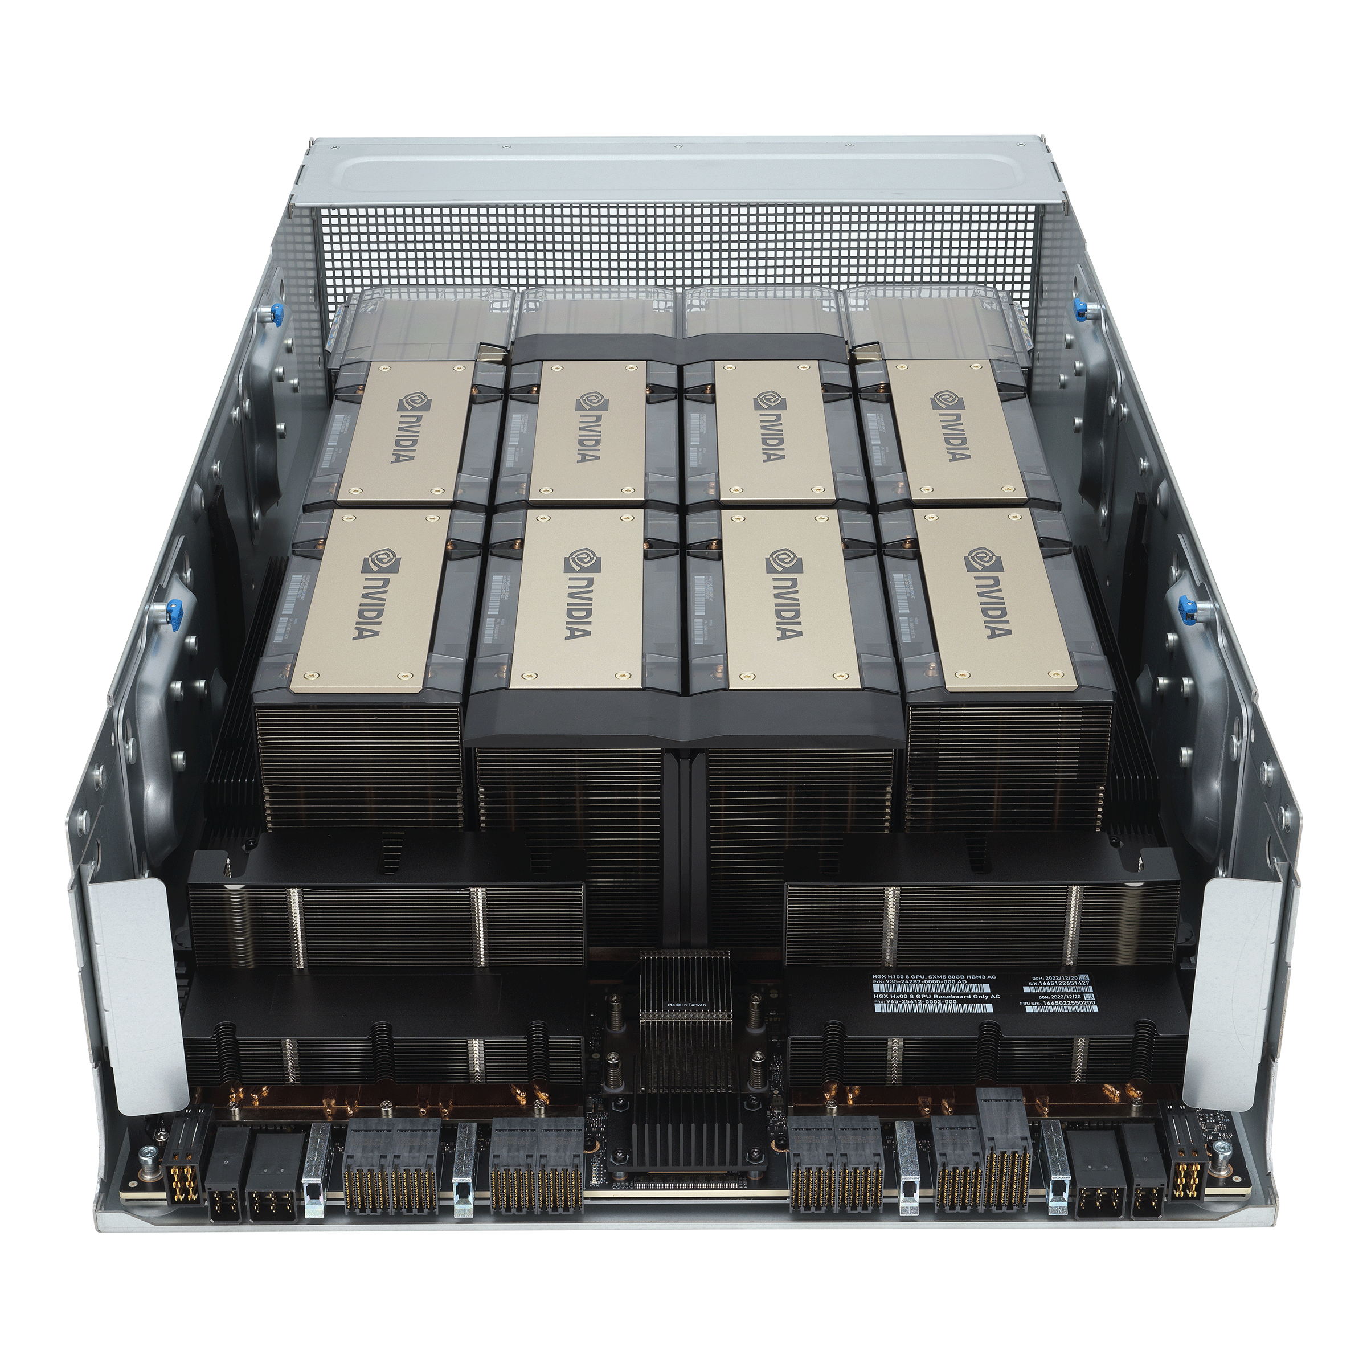



Background: AI Video Chat
This leads to models being deployed in the cloud and interacting with users through Real-time Video Communication (RTC).
Hi, take a look at this, could you ···
Video Communication
via the Network
Sure, this looks ··· , so we should ···
+
Response

Slide 8


Challenge: Low Latency
The response latency needs to stay below 300 ms for a fluent experience [2].
However, responses are generated through time-consuming inference.
Hi, take a look at this, could you ···
Video Communication
via the Network
Sure, this looks ··· , so we should ···
Not a real person
+
Response
Time left for RTC
at most 68 ms
Inference latency
at least 232 ms [1]
[1] Hurst, Aaron, et al. "Gpt-4o system card." arXiv preprint arXiv:2410.21276 (2024).
[2] Lai, Zeqi, et al. "SpaceRTC: Unleashing the low-latency potential of mega-constellations for real-time communications." IEEE INFOCOM 22.

Slide 9


Vision: reduce the latency to an extremely low level
I feel it’s a real human
Hi, take a look at this, could you ···
+
Response
Grasp the "holy grail" of AI research: Making AI like real humans.

Slide 10
Gap with Existing Methods
Existing RTC: Optimize for human perception.
AI Video Chat: Optimize MLLM performance.
GAP

Slide 11


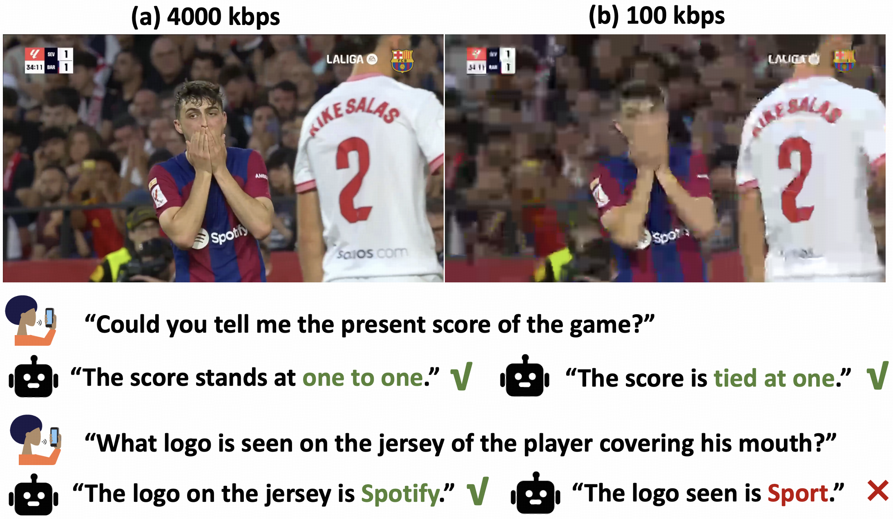
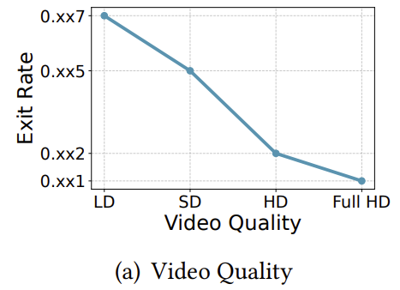
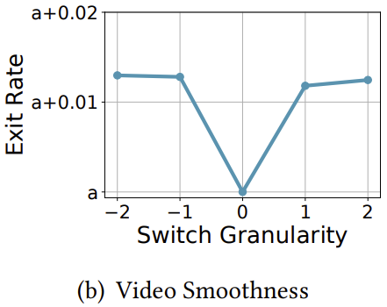
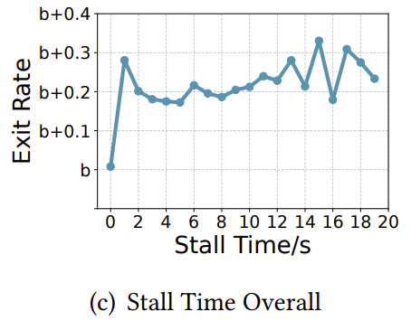
Gap #1: QoE undergoes fundamental changes
Quality degrades
Still correct
Dissatisfied
More stalling
Impatient
infinite patience
Bitrate switches
Unsmooth
No impact
[3] Jia, Lianchen, et al. "Towards User-level QoE: Large-scale Practice in Personalized Optimization of Adaptive Video Streaming." SIGCOMM 2025.

Slide 12
Gap #2: From physical time to positional encoding (PE)
Adds delay to ensure users experience a smoothly-paced video
Jitter Buffer
e.g., 100 ms
Frame arrivals are non-uniform
time
t+100 ms
t+199
t+133
t+166
PE(0)
PE(33)
PE(66)
PE(99)
t ms
t+45
t+60
t+110
time
MLLM’s perception of time doesn't rely on physical time, but rather on PE.
PE is only associated with the frame's capture time.
t+0 ms
t+60
t+110
t+45
time

Slide 13
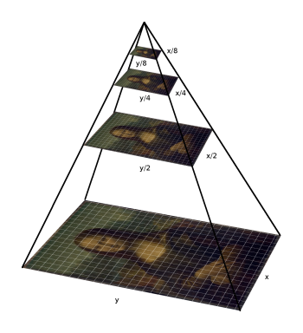
Gap #3: Viewer throughput changes
Human：can watch 8K @ 240 FPS, or even beyond that.
MLLM：at most 800x800 @ 2 FPS
Frame Rate Redundancy
Resolution Redundancy
…
…
…
…
0 ms
500 ms
1000 ms
time

Slide 14
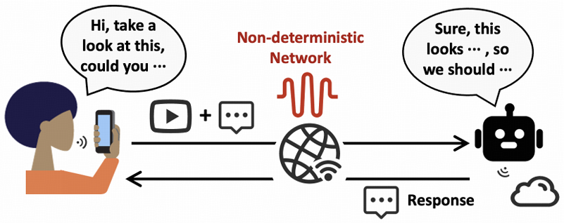
Call for AI-oriented RTC research
Call for MLLM-oriented RTC research
Exploring the network requirement shift
from“humans watching video”to“MLLM understanding video”

Slide 15
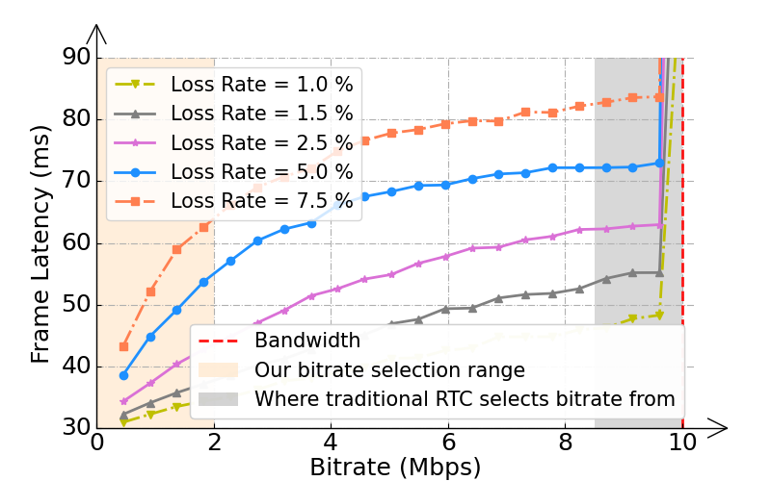
Case study #1: Context-aware Streaming
lowering the bitrate doesn't impact model accuracy?
bitrate selection in the opposite direction
Context awareness in video matters more than high bitrate.

Slide 16
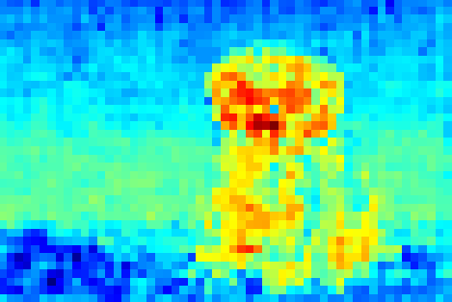
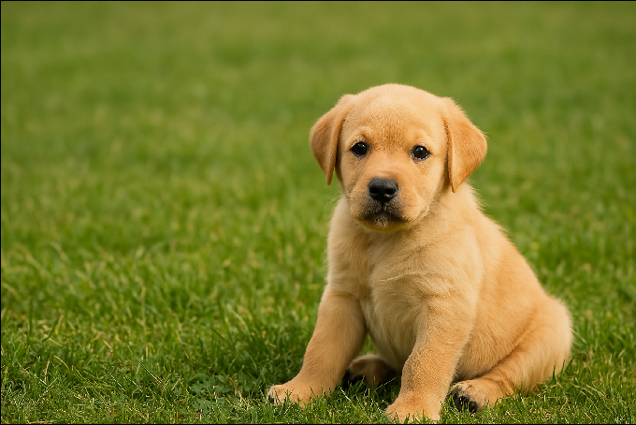
Case study #1: Context-aware Streaming
Allocating more bitrate to chat-important regions and less to irrelevant regions.
Is the dog in the video erect-eared or floppy-eared?
CLIP Text Encoder
High correlation
correlation
Low
CLIP Vision Encoder
QP Map Encoding

Slide 17
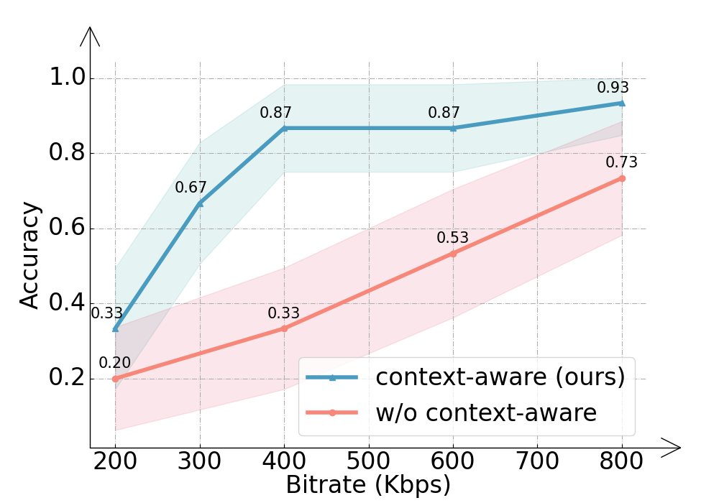
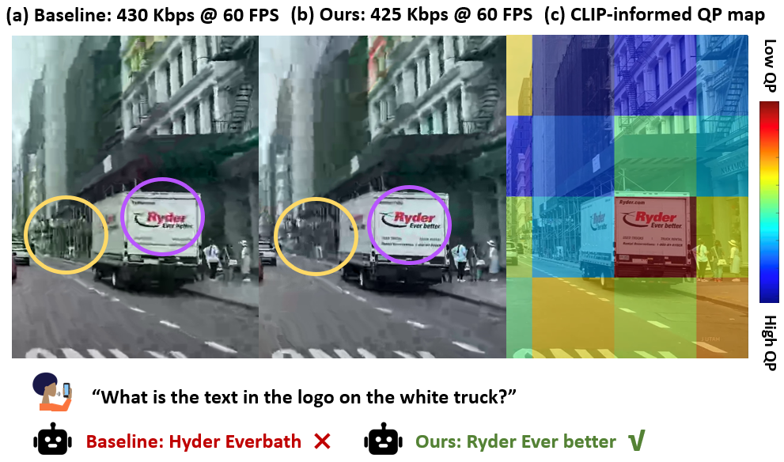
Case study #1: Context-aware Streaming
In this way, we can reduce the video bitrate while maintaining accuracy.
[4] test on https://github.com/pku-netvideo/DeViBench/blob/main/old_versions/datasets_v0.csv

Slide 18
Case study #2: The first benchmark
In existing benchmarks [5],
dialogues are too simple…
92%
8% (what we need)
We need more video quality-sensitive dialogues
to evaluate how quality degradation affects MLLM accuracy
[5] Lin, Junming, et al. "Streamingbench: Assessing the gap for mllms to achieve streaming video understanding." arXiv 2024.

Slide 19
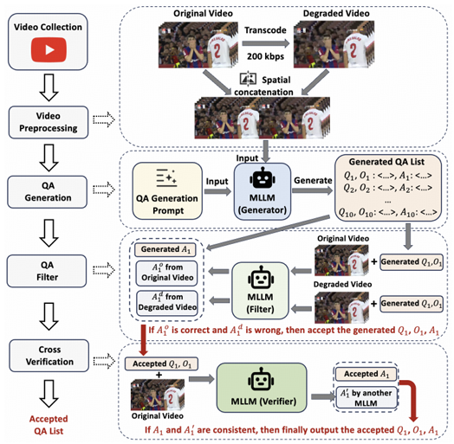
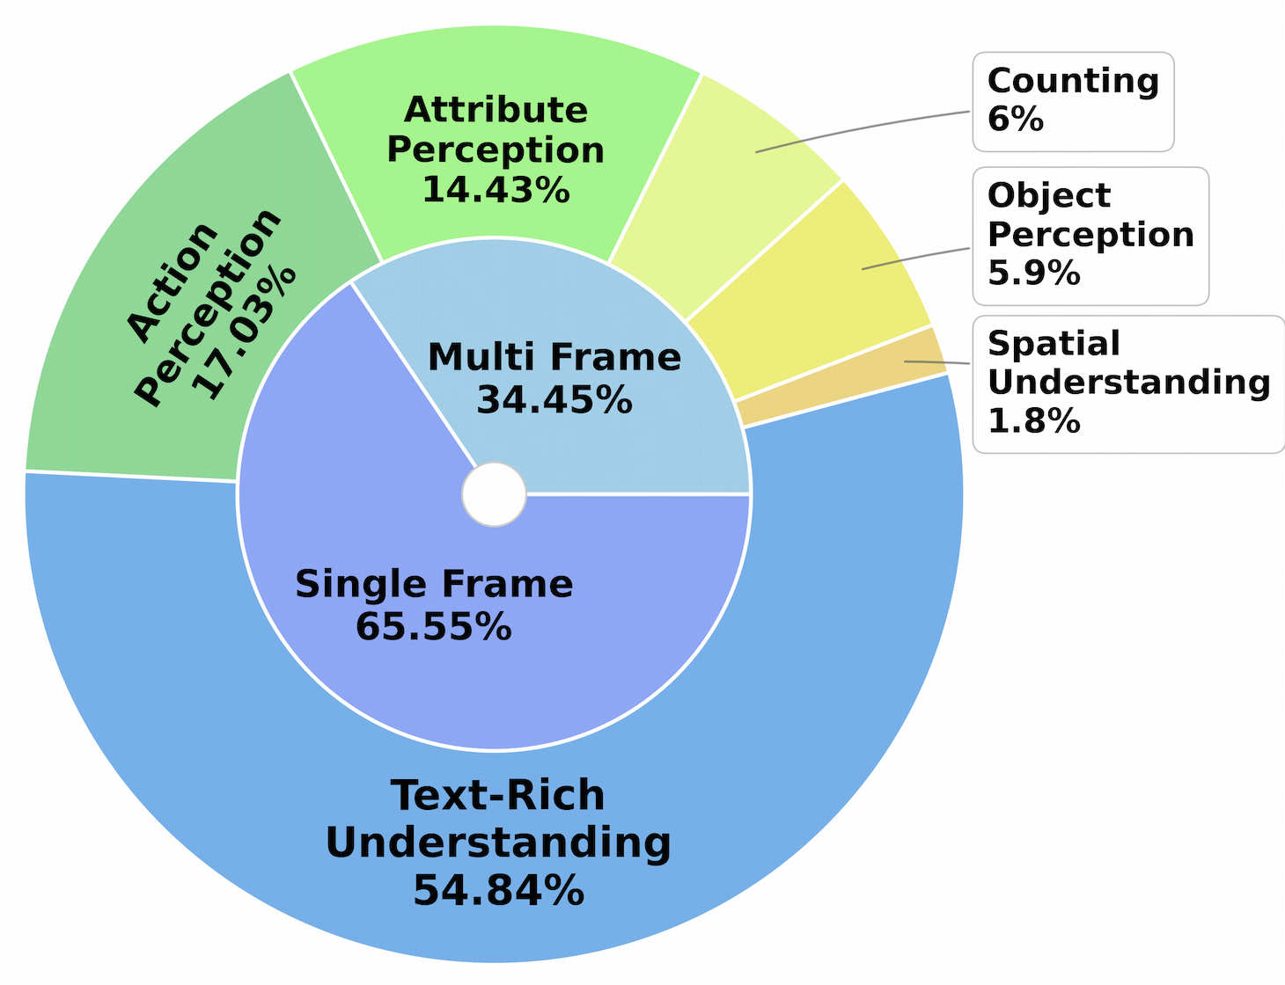

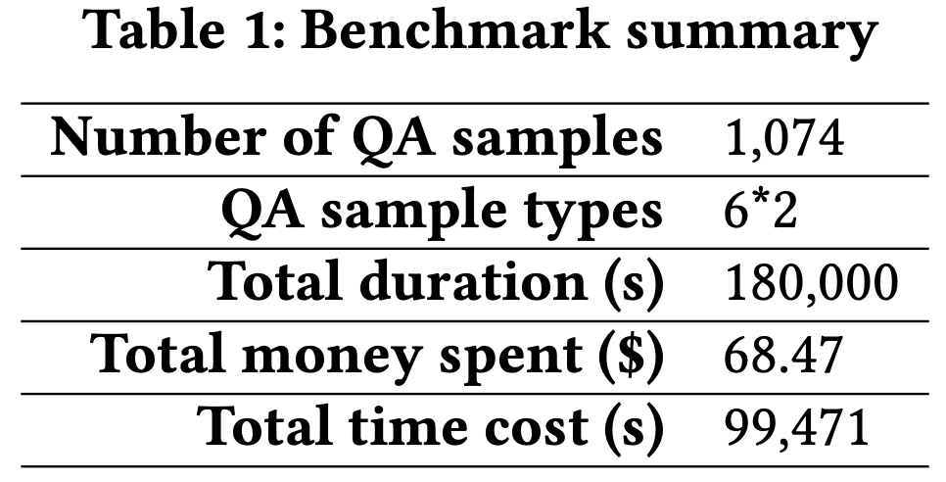
Case study #2: The first benchmark
Automatic
Benchmark construction
Benchmark
Distribution and Summary
GitHub repository

Slide 20
Conclusion
Video chat is evolving—we're now talking to AI instead of just humans.
Response latency is a key factor in whether AI behaves like a real human.
There are many gaps between existing RTC frameworks and AI video chat.
This work calls for MLLM-oriented RTC research and presents two case studies.
Thanks!
For any questions or further discussion,
please contact: jiangkai.wu@stu.pku.edu.cn

